Slide 1
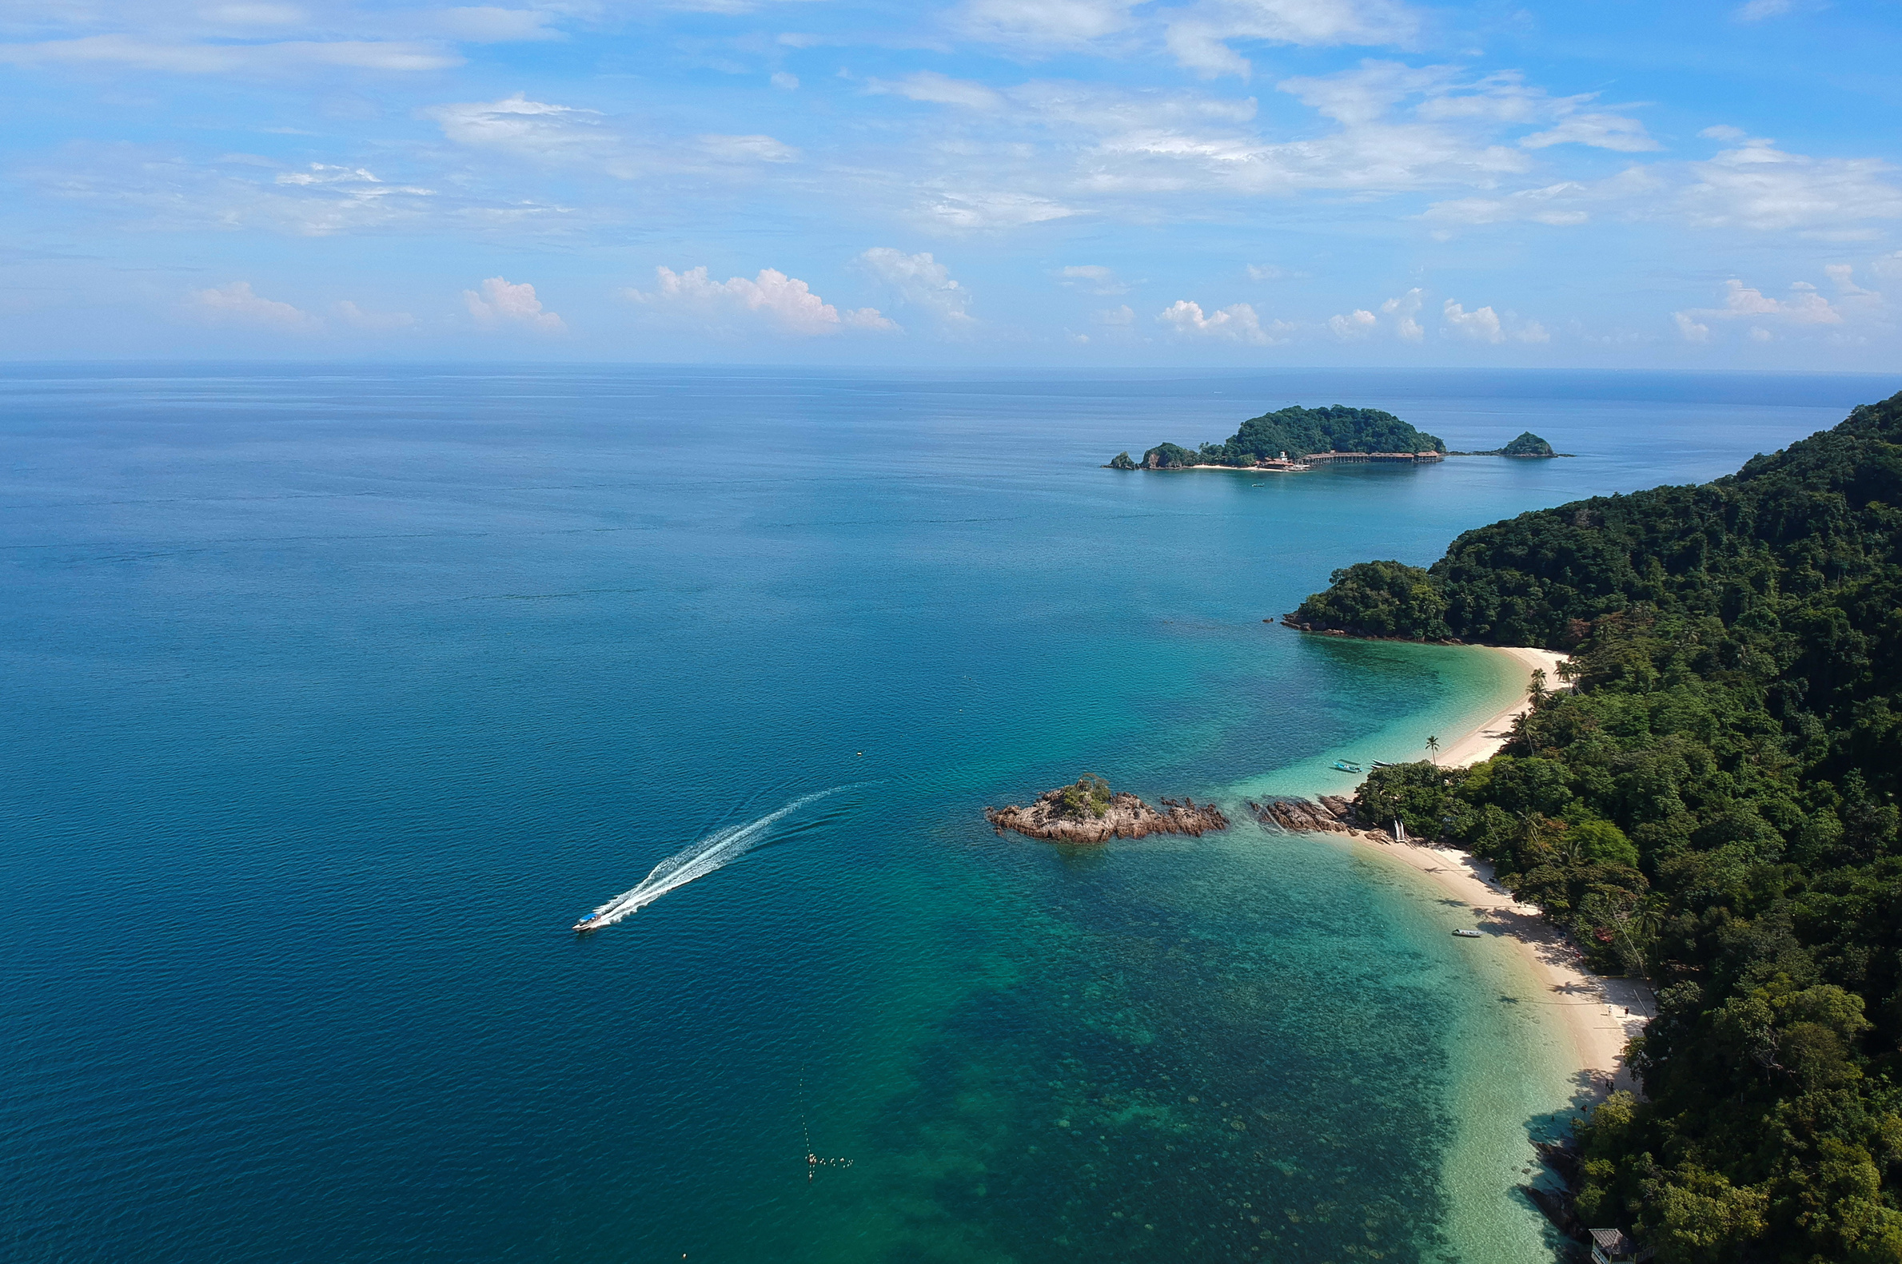
Tanzania
TRAVEL Experience
An Analysis of Tourist Experiences in Tanzania
Analysing Insights for Economic Growth
By
Osen Ajape

Slide 2

Introduction
I am using a dataset from Tanzania's tourism sector, which covers tourists travel purposes, companions, impressions, preferences, and demographics.
The tourist sector plays a vital role in the country's economy. The sector provides direct employment for over 600,000 people and generates significant revenue, primarily from Europe, the US, and Africa.
Tanzania has dedicated more than 25% of its land area to tourist attractions, including stunning landscapes, diverse wildlife, national parks, beaches, Africa’s highest mountain, rich culture, and friendly people. These features offer excellent opportunities for cultural tourism, beach holidays, honeymoons, game hunting, historical exploration, and some of the best wildlife photography safaris in the world.
Aim
The objective of this analysis is to explore the tourism dataset to gain insights into tourist satisfaction levels and experiences, identify areas for improvement, and make recommendations to attract more tourists to the country, enhance their experiences, and continue to enrich the Tanzanian economy through tourism.

Slide 3



Agenda
1
Travel Purpose and Age Group Distribution.
2
Age Distribution of Tourist and Count by Gender.
3
Top 10 Tourist Countries Visiting Tanzania and Their Travel Companions
4
Highlights of Tourists' Most Impressive Experiences and Feedback
5
First Trip to Tanzania or Not
6
Tourists Information Sources for Learning About Tourism in Tanzania
7
Conclusions and Recommendations

Slide 4
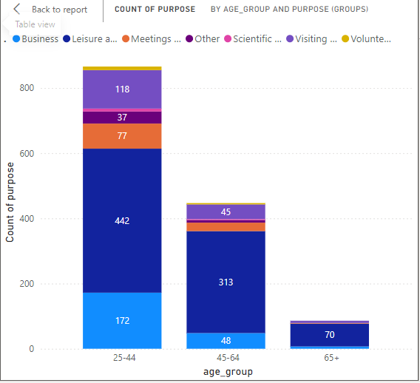
Leisure and Holidays dominate travel purposes for all age groups, indicating a strong preference for recreational travel. This preference is particularly high among younger adults (25-44 years).
Volunteering and Scientific and Academic travel are minimal across all age groups, suggesting these purposes are less common overall.
Tailor Services to Age Demographics: Recognize and adapt to the different travel needs and preferences across age groups to maximize engagement and satisfaction.

Slide 5
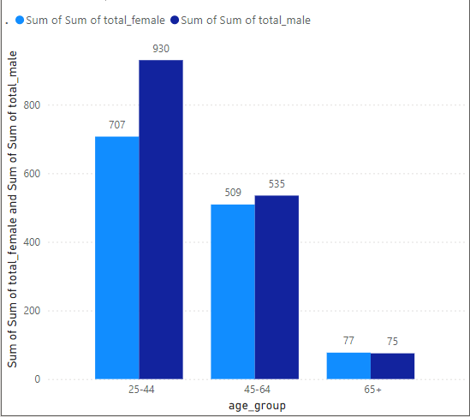
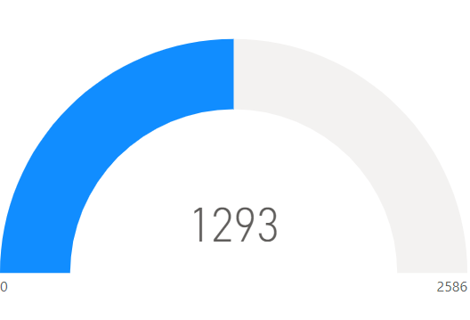
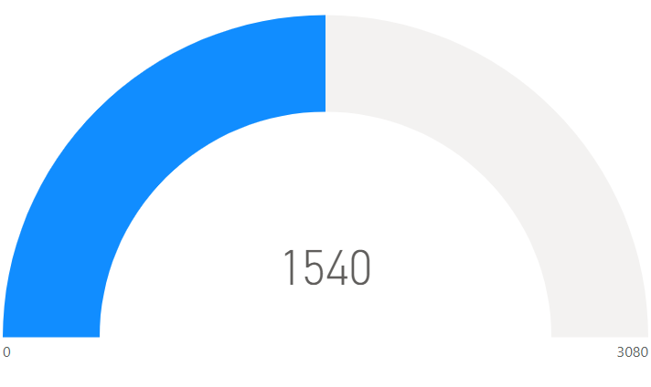
25-44 Age Group dominate traveller population of both genders into the country with approximately 57.8% of all traveller in the country.
44-64 Age Group represents the second-largest segment of travellers of both genders entering the country, accounting for approximately 36.85% of all travellers.
65+ Age Group represents the smallest proportion of travellers of both genders entering the country, accounting for approximately 5.37% of all travellers.
There is no significant difference between the genders of travellers, where the female made up to 45.64% of the tourist while the male made up to 54.35% of tourist.
Female
Male

Slide 6
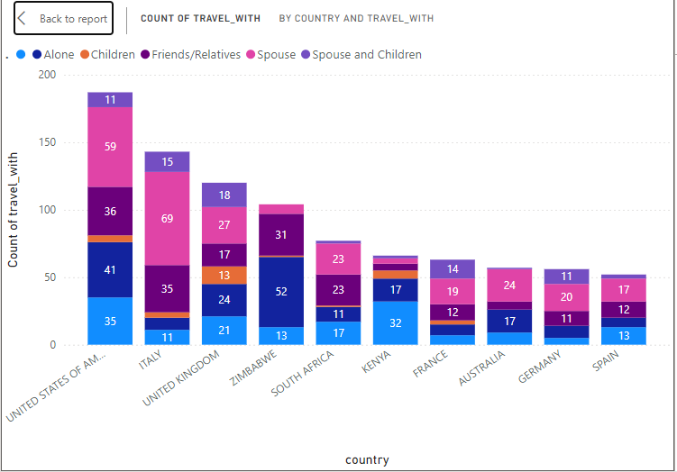
The United States shows high number of traveller from the top 10 tourist country to Tanzania
Italy and the United States are the top countries where travellers frequently visit with a spouse. Italy leads with 69 counts, followed by the USA with 59 counts
Zimbabwe has the highest number of solo travellers at 52, followed by the United States with 41 solo travellers
The United States leads with 36 counts, followed closely by Italy with 35 counts, while Zimbabwe and South Africa also show a significant number of travellers visiting with friends/relatives

Slide 7
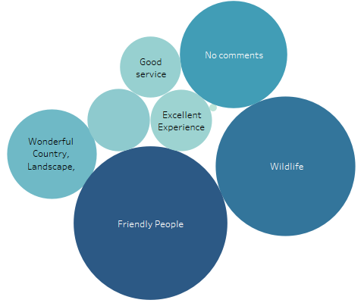
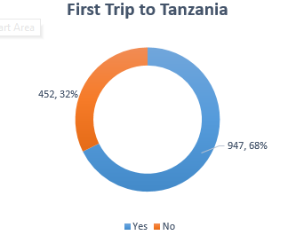
Tourist Most Impressive Experiences
First Trip to Tanzania
462
144
Historical
Exploration
167
133
303
726
890
The most remarkable aspect of tourists' experiences in Tanzania, revealing that only 4.7% of visitors rated their overall experience as excellent, making it the least impressive among various factors. In contrast, tourists found the people of Tanzania to be friendly, with this aspect being the most impressive experience for 31.5% of visitors. The second most impressive experience was Tanzania's wildlife, which was highlighted by 25.7% of tourists.
The low overall experience reported by most tourists is believed to be a key reason for the low return rate among visitors to Tanzania. Data indicates that only 32% of tourists have visited Tanzania before, while a significant 68% are first-time visitors to the country.

Slide 8
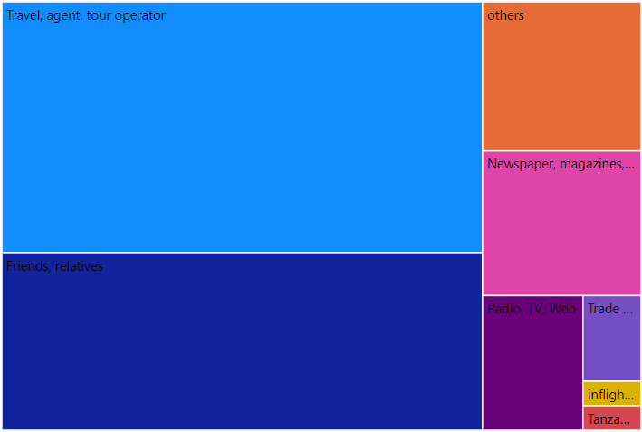
Effectiveness of Awareness Sources for Tanzania Tourism
It was found that nearly half (49.3%) of tourists in Tanzania became aware of the country's tourism opportunities through travel agents and tour operators. This indicates that many tourists prefer to consult travel experts, such as agents or operators, before planning their trips to ensure they have an enjoyable experience tailored to their travel purposes.
It was found that the second-largest group of tourists in Tanzania, accounting for 29.6%, learned about the country’s tourism through friends, family, and close acquaintances who had first-hand experience or heard about it. This underscores the importance of ensuring that tourists in Tanzania have a great experience, encouraging them to return and recommend the destination to their close circles.
All other sources of awareness for Tanzania tourism collectively accounted for 21.1%, making them the least effective.
1388
214
199
835
139
42

Slide 9


Conclusion
The analysis reveals key insights into tourism in Tanzania. Nearly half of the tourists became aware of the country through travel agents and tour operators, highlighting the importance of these channels. Personal referrals from friends and family account for 29.6%, emphasizing the need for positive experiences to encourage repeat visits and recommendations. However, only 4.7% of tourists rated their overall experience as excellent, which likely contributes to the low return rate, with 68% being first-time visitors. The dominant age group of travellers is 25-44, primarily visiting for leisure, suggesting a strong focus on enhancing recreational activities. Tailoring services to meet the preferences of different age groups could improve overall satisfaction and increase the likelihood of repeat visits. The United States and Italy emerge as key markets, with a significant number of tourists traveling with a spouse or partner.
Tanzania
TRAVEL Experience

Slide 10

Recommendations
Strengthen Partnerships with Travel Agents and Tour Operators:
Collaborate to create attractive packages and provide up-to-date promotional materials.
Improve Overall Tourist Experiences:
Address areas where tourist satisfaction is low, such as overall experience, and take steps to improve these aspects.
Improve on building new evolving attractions and infrastructure to enhance satisfaction.
Regularly gather and act on tourist feedback to refine the experience.-
Leverage Word-of-Mouth Referrals:
Encourage satisfied tourists to share experiences with friends, family, and online.
Implement referral programs offering discounts for recommendations.
Enhance Recreational and Leisure Activities:
Develop a variety of activities catering majorly to the 25-44 age group and other age group, including adventure tourism and cultural experiences.
Target Key Markets – USA and Italy:
Increase marketing efforts in the United States and Italy, focusing on the high number of tourists from these countries
Develop special packages for couples, given the significant number of travellers visiting with a spouse or partner.

Slide 11
Thank you
I’m open to any questions
you may have.

